Slide 1
Laser Cooling by Sawtooth Wave Adiabatic Passage
Huan Q. Bui
ZGS – August 26th, 2022

Slide 2
Laser Cooling

Slide 3
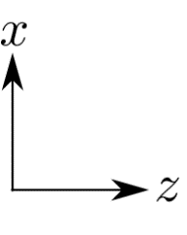
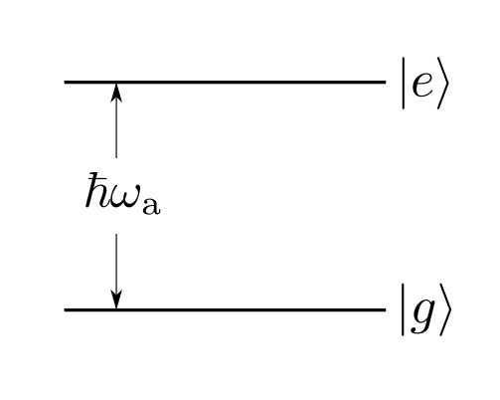
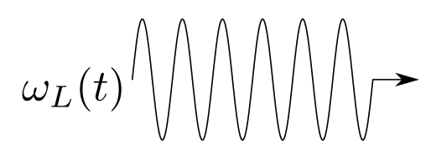
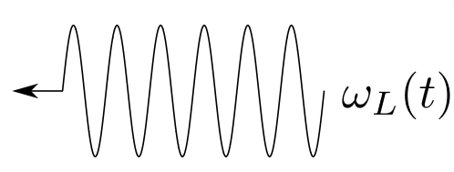
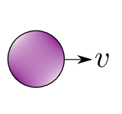


Basic mechanism

Slide 4
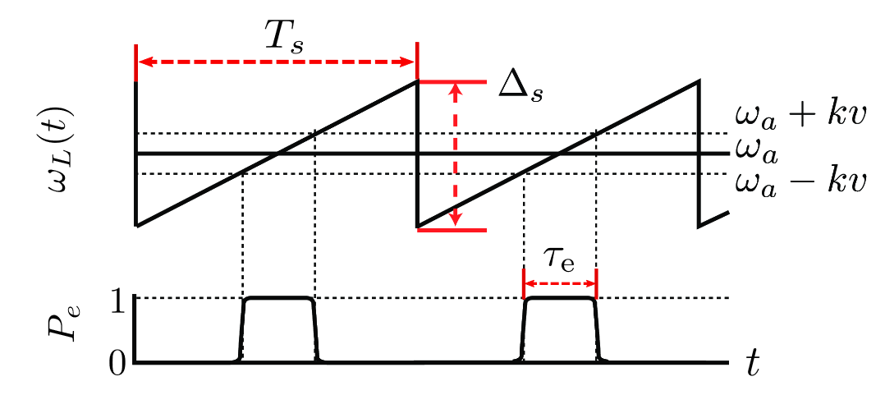


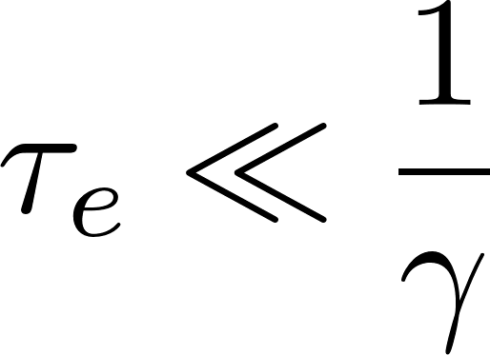

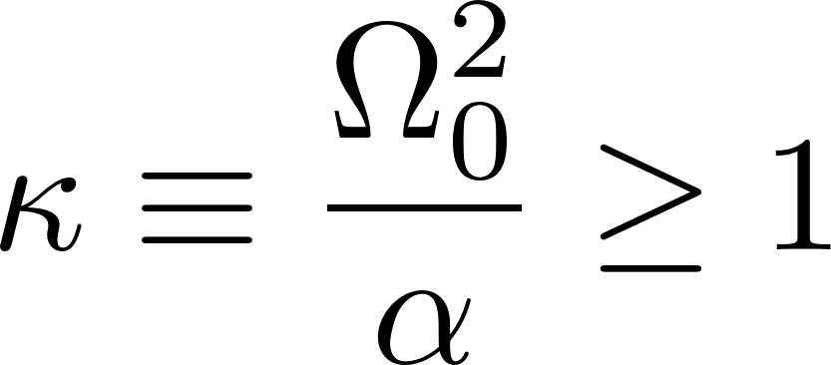



Requirements
Must begin sweep in :
Low decay probability during :
Large adiabatic transition probability:
: adiabaticity parameter

Slide 5

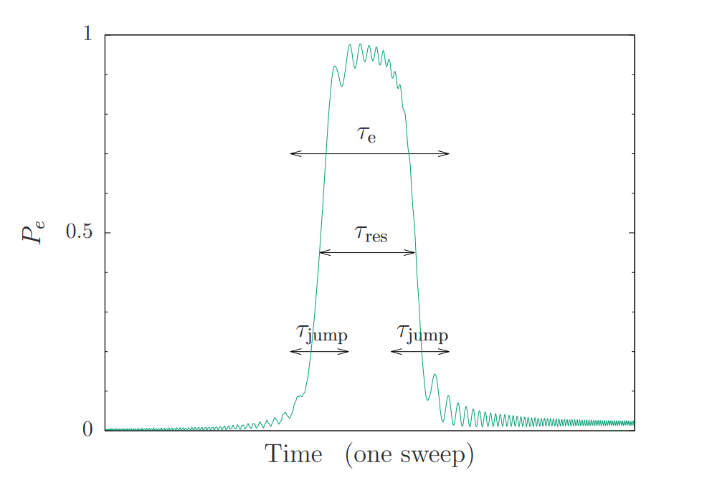




Validity
Particle interact sequentially with one wave and then the other
→ Need sufficiently large
When adiabatic:
Want

Slide 6
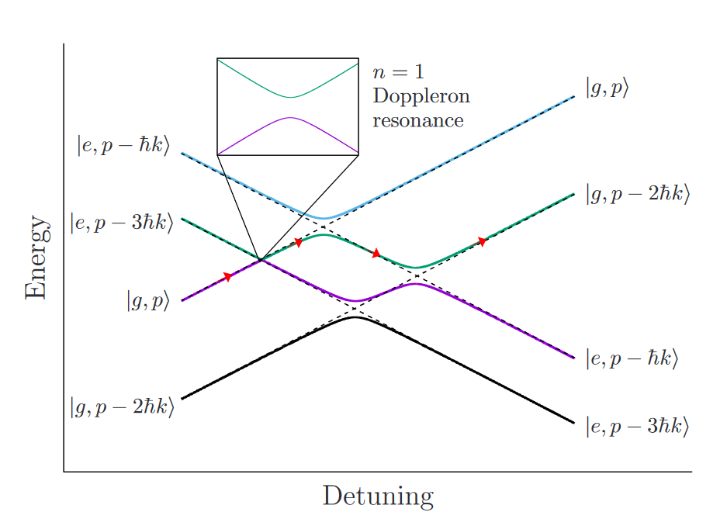


Dynamics
Large detuning limit:

Slide 7

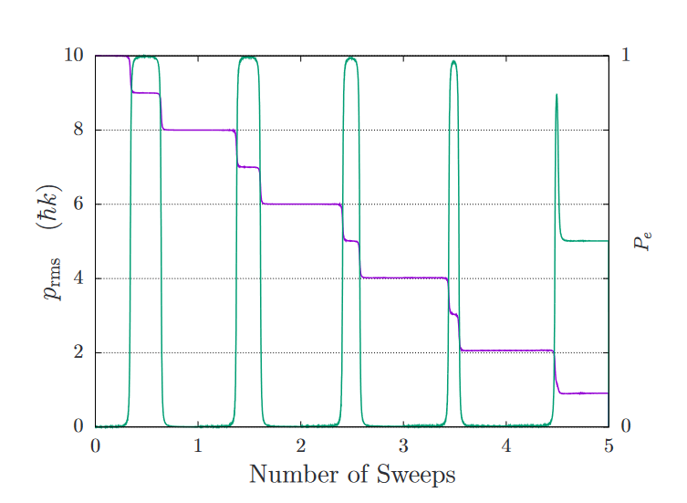
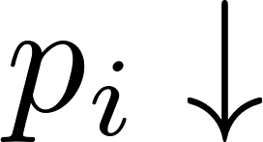


Dynamics:
Coherent evolution:
→ Doppler shift decreases → pulse narrows
Effective force drives particle to zero velocity
→ unlike “slowing force” that does not lead
to steady-state cooling
With spontaneous emission:

Slide 8
Dynamics: with spontaneous emission

Slide 9
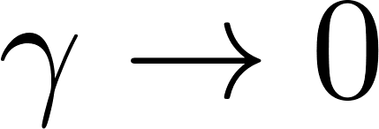
Temperature limit as

Slide 10
Cooling efficiency

